Slide 1
Youth Justice Community Engagement Study with the Crawford County Restorative Justice Authority (JD #11)
Supported by the KS Department of Corrections and the Kansas advisory Group on juvenile justice and delinquency Prevention
Facilitated by the KU Center for Community health and development

Slide 2
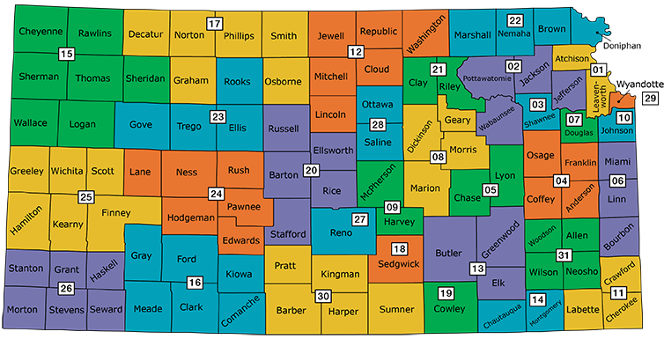
KDOC Pilot Project
KDOC
Identification of pilot counties based on DMC (RED) Data and Disparities
Wyandotte County
ThrYve/JCAB
Crawford County
Collaborative Support: Restorative Justice Authority; Learning Tree Institute
Notes:
1. Population at risk (age 10 through 17 ) 2. Juvenile Arrests 3. Refer to Juvenile Court 4. Cases Diverted 5. Cases Involving Secure Detention 6. Cases Petitioned (Charge Filed) 7. Cases Resulting in Delinquent Findings 8. Cases resulting in Probation Placement 9. Cases Resulting in Confinement in Secure Juvenile Correctional Facilities 10. Cases Transferred to Adult Court

Slide 3
SPECIFIC KDOC COMMUNITY ENGAGEMENT GOALS
MAKE PROGRESS
GOAL 1
GOAL 2
GOAL 3
Increase community capacity to collect data from juvenile justice decision points.
Assist in collecting data for last three fiscal years
Increase community’s data analysis and interpretation capacity.
Complete a thorough data analysis of juvenile justice data from the past three years.
Identify system gaps and outcomes for youth could be improved via justice system improvement or other system interventions
Increase community’s collaborative capacity.
Assist to identify and approach other stakeholders that need to be brought in to address the identified system improvement needs
Develop toolkit detailing steps taken and lessons learned to be utilized by other Kansas communities.
Notes:
1. Opportunity for year-round community program, including resource for summer program that we hope in partnership with schools
2. Awarded by HHS, OMH MYVPP2 Grant Program; FY17 Minority Youth Violence Prevention II (MYVP II): Integrating Social Determinants of Health and Community Policing Approaches
1 of 10 grantees (Loyola Univ-Chicago, Rutgers- NJ, Kentucky State Univ, ST Louis County Dept of PH,
3. 1 year grant of 4 year grant award-- Award amount is $425,000 (approximately $300,000 for Direct Costs for Project)
4. 3 Aims

Slide 4
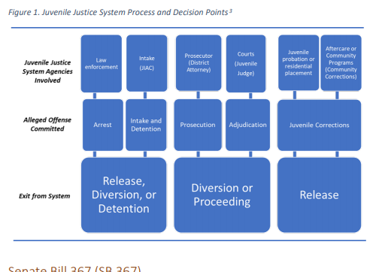

Slide 5
KDOC COMMUNITY ENGAGEMENT INITIATIVE
DELIVERABLES
DELIVERABLE 1
DELIVERABLE 2
DELIVERABLE 3
Strategy recommendations with particular focus on:
Disparities focus on vulnerable populations (RED/DMC; LGBTQI; undocumented youth/families)
Youth Justice Toolkit
and
Indicator Dashboard
Juvenile Justice Assessment and Community Engagement Study

Slide 6
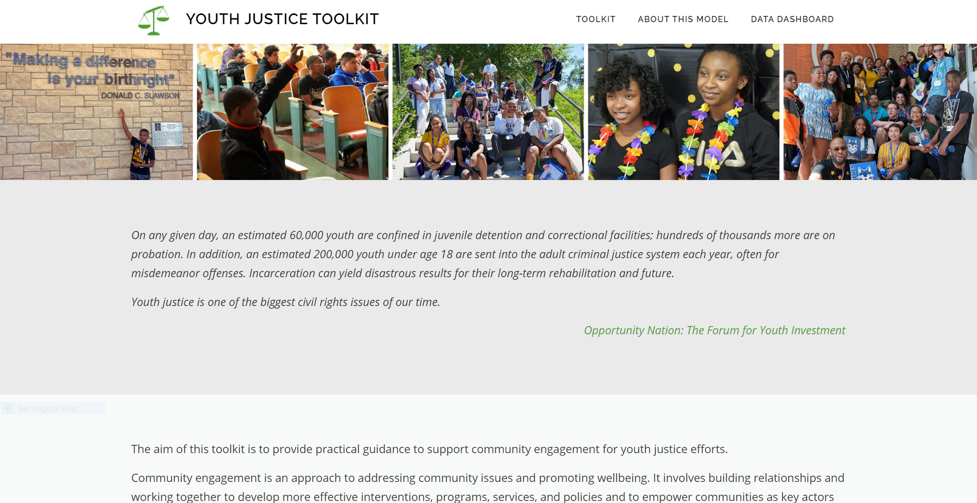
Youth Justice Toolkit https://youthjustice.ctb.ku.edu/

Slide 7
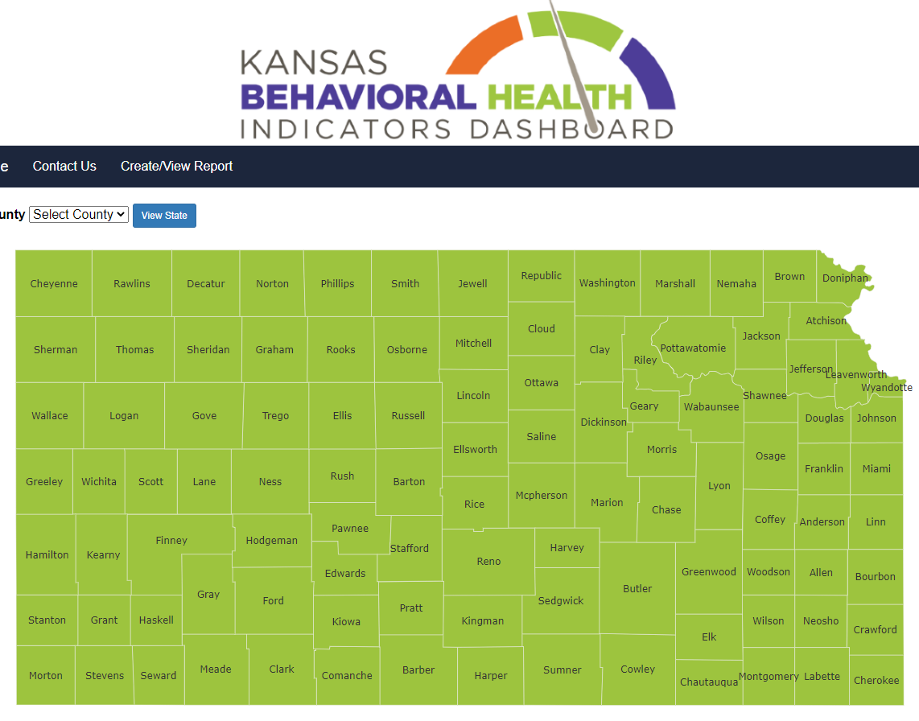
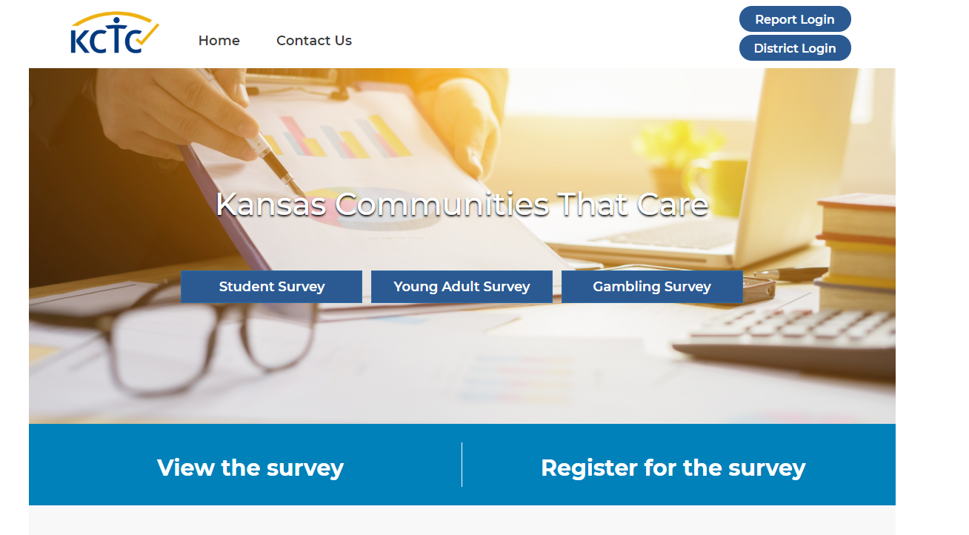
Indicator Dashboard
Access over 25 Measures
Guided by the 10 Essential Questions for Juvenile Justice

Slide 8
Wyandotte County Youth Justice Study

Slide 9
Change Levers
Changing Consequences
Changing Policy & Systems
Program & Practices
Providing Information & Enhancing Skills
Policy & Systems
Enhancing Services & Supports
Modifying Access, Barriers, Opportunities
Notes:
A Lever- strong bar that is used to lift and move something heavy.
Based on principles of behavioral science
Focuses on antecedents (before behavior occurs; enables behavior) to support desired response
Providing information and enhancing skills
Providing Services and Supports
Modifying Access Barriers and Opportunities
Focuses on consequent conditions (after behavior/response occurs)
Change consequences (e.g., Cease Fire)
Change policies & broader systems (e.g.,

Slide 10
What do we care about and why?
How can this be helpful to you locally?

Slide 11
Assessment Questions of Interest: What do we want to know or better understand about the juvenile justice system and/or youth involvement?
Why is it helpful to support a juvenile justice system study?
What does success look like for youth? What does success look like for youth who are justice involved?
What does success look like for our juvenile justice system?
What would success look like for the Crawford County Restorative Justice System?
What key organizations, agencies, groups, or individuals need to be involved in assessing JD #29?

Slide 12
Why? What?
What are we doing well in the juvenile justice system?
What are some challenges?
What are the problems and goals we can address through the juvenile justice system assessment?
What type of data or information are we interested? What do we need to better understand?

Slide 13
Study Process
What to Expect

Slide 14
KDOC/RJA JUVENILE JUSTICE ASSESSMENT
ASSESSMENT QUESTIONS & FUNDAMENTAL INDICATORS
Key Juvenile Justice System Questions
The Fundamental Measures are built on a framework that focuses on ten core questions for juvenile justice systems to answer.
How many youth are involved in various stages of the system?
What are the key characteristics of the youth involved?
How did the youth become system involved?
How did the youth move through the system?
Is the system fair?
How did the youth change while in the system?
Does the system meet the needs of youth and families?
What was the experience of youth in the system?
How much does it cost?
What are the long-term measures of success?
National Center for Juvenile Justice Fundamental Measures of Juvenile Justice
National Center for Juvenile Justice http://www.ncjj.org/Projects/model_data_project.aspx
Foundational Measures for Juvenile Justice; http://www.ncjj.org/fmjj/

Slide 15
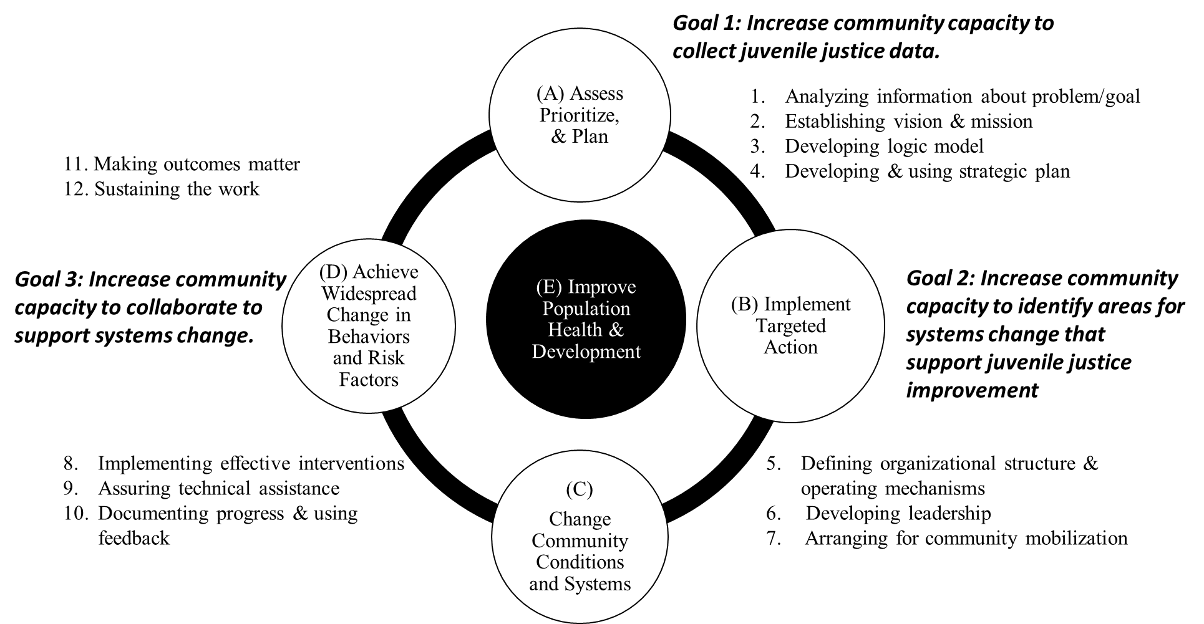

Slide 16
Assessment Process Summary
Identify Key Partners to Interview for CC juvenile justice system and youth-serving agencies
Data for last 3 years gathered for indicators, gaps identified
Community review of Phase 1 of Assessment Findings & Consider Feasibility of Strategy Recommendations
Informational Interview & focus groups with juvenile justice agency representatives
Surveys about outcomes/data capacity, gaps, and enhancement areas (OJJDP Model Data Project)

Slide 17
Elements of Needs & Resources Assessment:
Work with agencies and stakeholders to:
Collect Data
Data from juvenile justice agencies
Interviews with stakeholders
Analyze Data
Collaborate on solutions
Particular focus on vulnerable populations:
Racial and Ethnic Disparities
LGBTQI+
Undocumented
DELIVERABLE 1
JD #11 Juvenile Justice Needs & Resources Assessment

Slide 18
Wyandotte County Example
Wyandotte county Youth Justice Study

Slide 19
Juvenile Justice Needs and Resource Assessment
Guiding Questions:
Who is in the juvenile justice system?
What are the characteristics of those in the system?
Are there disparities for youth in the system?
How do youth become involved in the system?
How do youth move through the system?
Does the system meet the needs of youth?
What is the experience of youth in the system?
What are the long-term measures of success?
What is the capacity of the local system?

Slide 22
Strategy Recommendations
System Gaps/Disparities | System Improvements | Potential Change Lever Considerations
Tracking Youth: No way to track a given youth from arrest through discharge. Being able to track youth would allow for better understanding of the youth experience with the system. | Integrated, centralized data system where youth information is collectively stored. | 1. Develop and provide integrated tracking system to support electronic collection and sharing of information across the justice system and partner agencies (e.g., DCF, School). 2. Support centralized platforms across agency partners to coordinate electronic forms and data collection (e.g., risk and need assessment on paper). 3. Support integrated data reports and collaborative cross-agency review to system and multiple agencies within juvenile justice system and/or related systems (e.g., DCF, School).
Data Collection: Improve data collection relating to adjudications and dispositions from the courts with demographic characteristics, involvement with DCF (crossover youth), utilization of victims' services, and lengths of time it takes to move through various stages of the system. | Establish enhanced data-collection guidelines/policies. Provide resources and support for integrated data personnel across systems/partners. | 1. Establish protocols for all agencies involved in the juvenile justice system to collect data on youth pertinent to their office and to record the data electronically. 2. Identify key data that should be minimally collected and shared across agencies. 3. Provide resources and supports for shared infrastructure and personnel who can work across agencies/systems to centralize data collection.
Strategies related to 23 gaps and disparities for system improvement and capacity for data use were identified.

Slide 23
WYCO Challenges and Strength
Strengths
ThrYve Youth Collaborative
KU CCHD/ThrYve Knowledge & Relationships
ThrYve Youth Justice & Crime Prevention Partners Guided Process and System
JCAB Support
Supported Dialogue, Reflection, and Examining System Across System Partners
Justice System Understanding
Review in All Stages with Group
KDOC Program Officer Engagement
Challenges & Opportunities
Awareness of KDOC Pilot Selection
Resources to support large data system changes
Identifying core set of data indicators
Identified systems gaps (e.g., arrests and response)
Consider how to reduce calls for law enforcement to certain areas
Consider alternatives across system (e.g., arrest, diversion, etc)

Slide 24
Crawford County Preliminary Data Review and Senemaking
Restorative Justice Study
What are we seeing? What does it mean?

Slide 25
Review subset of data collected and analyzed to date
Quantitative/hard data
Interview data
Discuss findings and gaps
What are we seeing? What does it mean?
What do we know? What do we want to know?
How can we use this data for improvement in how youth are served?
How can we tweak the system to address disparities?
Crawford County

Slide 26
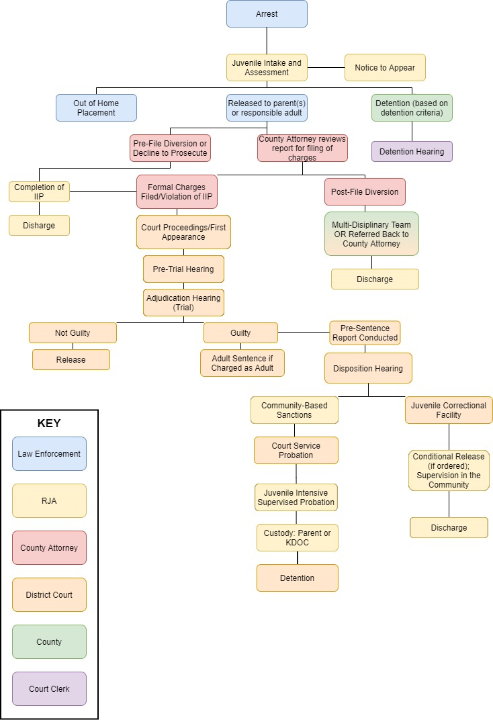
Arrest
Diversion
Detention
Delinquency/Guilty Findings
Notes:
Note: Red circles denote where we’ve received data from the state, blue circles denote where we’ve received data from the county

Slide 27
Notes:
Note: Red circles denote where we’ve received data from the state, blue circles denote where we’ve received data from the county

Slide 28
Notes:
Note: Red circles denote where we’ve received data from the state, blue circles denote where we’ve received data from the county

Slide 29
Discussion Questions:
What are we seeing?
What does it mean?
What else do we need to know?
Source: KDOC
Notes:
When describing RRI, summarize following point to direct room to why examining data in this way: The result of that comparison is a calculation termed the Relative Risk Index (RRI). It must be emphasized that the RRI is designed as a first step in examining Disproportionate Minority Contact. The RRI is used to point to areas for more intensive examination, and to serve as an ongoing set of ‘vital signs’ or ‘early warning system’ for the management of the juvenile justice system.

Slide 30
Discussion Questions:
What are we seeing?
What does it mean?
What else do we need to know?
Source: KDOC

Slide 31
Discussion Questions:
What are we seeing?
What does it mean?
What else do we need to know?
Source: RJA
Notes:
When describing RRI, summarize following point to direct room to why examining data in this way: The result of that comparison is a calculation termed the Relative Risk Index (RRI). It must be emphasized that the RRI is designed as a first step in examining Disproportionate Minority Contact. The RRI is used to point to areas for more intensive examination, and to serve as an ongoing set of ‘vital signs’ or ‘early warning system’ for the management of the juvenile justice system.

Slide 32
Discussion Questions:
What are we seeing?
What does it mean?
What else do we need to know?
Source: KDOC

Slide 33
Discussion Questions:
What are we seeing?
What does it mean?
What else do we need to know?
Source: KDOC

Slide 34
Discussion Questions:
What are we seeing?
What does it mean?
What else do we need to know?
Source: KDOC

Slide 35
Discussion Questions:
What are we seeing?
What does it mean?
What else do we need to know?
Source: KDOC

Slide 36
Discussion Questions:
What are we seeing?
What does it mean?
What else do we need to know?
Source: KDOC

Slide 37
Discussion Questions:
What are we seeing?
What does it mean?
What else do we need to know?
Source: KDOC

Slide 38
Discussion Questions:
What are we seeing?
What does it mean?
What else do we need to know?
Source: KDOC

Slide 39
Discussion Questions:
What are we seeing?
What does it mean?
What else do we need to know?
Source: KDOC

Slide 40
Discussion Questions:
What are we seeing?
What does it mean?
What else do we need to know?
Source: KDOC

Slide 41
Discussion Questions:
What are we seeing?
What does it mean?
What else do we need to know?
Source: KDOC

Slide 42
Discussion Questions:
What are we seeing?
What does it mean?
What else do we need to know?
Source: RJA

Slide 43
Discussion Questions:
What are we seeing?
What does it mean?
What else do we need to know?
Source: RJA

Slide 44
Interviews
Shared interest in evidence-based, data-driven approaches to minimize & avoid youth contact with the system
Poverty/low income cited as driver of involvement with JJ system
Strengthening relationships with youth and families is shared priority
Frontline staff capacity & limited resources exacerbated by COVID-19 pandemic

Slide 45
Discussion
What do we know?
What do we want to know?
Are there data available that could help us understand this? How do we get it?
Data requests from KU across system
How can we use this data for improvement in how youth are served?
How can we tweak the system to address disparities?

Slide 47
Next Steps:
Additional Data Requests
Additional interviews
Compilation of draft report
Review of report for feedback
Dissemination and review of report with other key stakeholder audiences
Identification of 1-2 change levers (areas for system change)
What is next in process?

Slide 48
Thank you for your partnership!
Contacts:
Josh Harsin, MA jharsin@ku.edu
Jerry Schultz, Ph.D. jschultz@ku.edu
Jomella Watson-Thompson, Ph.D. jomellaw@ku.edu

